Slide 1
An easy to use RPC framework
implemented by C++11/14
Yu Qi
qicosmos@163.com

Slide 2
Outline
1.Introduction to RPC
2.What is rest_rpc?
3.Ease of use challenges
4.Key technologies

Slide 3
Introduction to RPC
Remote Procedure Calls
Call functions on the remote computer just like local function calls
Advantages:
Very easy to use, hide complications and details of network and framework
Greatly improve the efficiency of the development of interprocess communication

Slide 4
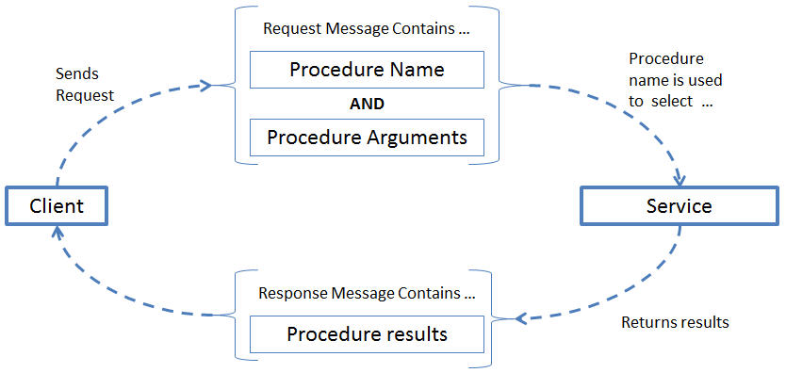
Introduction to RPC

Slide 5
Introduction to RPC

Slide 6
Outline
1.Introduction to RPC
2.What is rest_rpc?
3.Ease of use challenges
4.Key technologies

Slide 7
What is rest_rpc
server code:
//business logic
int add(int a, int b) { return a + b; }
int main()
{
using server_t = rpc::server<rpc::msgpack_codec>; //define serialization policy
server_t server{ port, pool_size, std::chrono::seconds{ 2 } };
server.register_handler("add", add); //register business handler
server.start();
}

Slide 8
What is rest_rpc
features of rest_rpc
easy to use
rapid development
flexible
https://github.com/topcpporg/rest_rpc

Slide 9
What is rest_rpc
Sever core code:
int add(int a, int b) { return a + b; } //business logic
using server_t = rpc::server<rpc::msgpack_codec>; //define serialization policy
server.register_handler("add", add); //register business handler
Client core code:
TIMAX_DEFINE_PROTOCOL(add, int(int, int));
rpc::sync_client<msgpack_codec> client;
auto result = client.call(endpoint, add, 1, 2);

Slide 10
Outline
1.Introduction to RPC
2.What is rest_rpc
3.Ease of use challenges
4.Key technologies

Slide 11
Challenges
How to register callable of any signature
How to route to the correct handler
How to simplify the call code

Slide 12
Outline
1.Introduction to RPC
2.What is rest_rpc?
3.Ease of use challenges
4.Key technologies
5.What can you do with it?

Slide 13

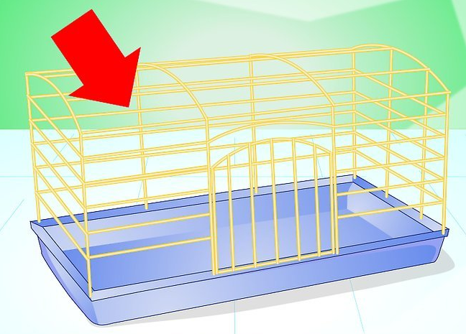
Challenges

Slide 14
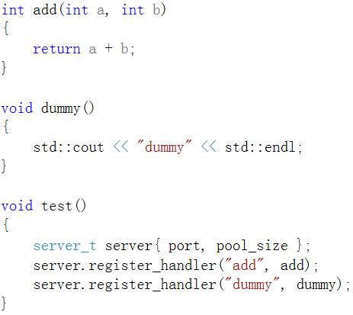
Register callable of any signature
different kinds of functions
in one container

Slide 15
Register callable of any signature
C++ has no such container
type erase

Slide 16
Type erase
No!
The number of types is limited

Slide 17
Type erase
No!
can’t any_cast
lost type information
return type
arguments type
reference
const volatile
……
int
int&
int&&
const int&
……
modern c++ can solve the problem

Slide 18
Register callable of any signature
A special type erase
template<typename Function>
struct invoker
{
static inline void apply(const Function& func, char const*, size_t){}
};
carry function type information
can accept any callable

Slide 19
Register callable of any signature
type erase
std::bind(&invoker<Function>::apply, f, _1, _2)

Slide 20
Register callable of any signature
struct server_t{
template<typename Function>
void register_handler(std::string const & name, const Function& f){
using std::placeholders::_1;
using std::placeholders::_2;
this->invokers_[name] = { std::bind(&invoker<Function>::apply, f, _1, _2)
};
private:
std::map<std::string, std::function<void(char const*, size_t)>> invokers_;
};
invoker<Function>::apply

Slide 21
Register callable of any signature
server_t server;
server.register_handler("add", [](int a, int b) {return a + b; });
server.register_handler("dummy", []{ });
server.register_handler("get_str", [](double v) { std::to_string(v); });

Slide 22


How to route to the correct handler

Slide 23
How to route to the correct handler
template <typename CodecPolicy>
struct server_t{
template<typename Function>
void register_handler(std::string const & name, const Function& f){
using std::placeholders::_1;
using std::placeholders::_2;
this->invokers_[name] = { std::bind(&invoker<CodecPolicy, Function>::apply, f, _1, _2) };
}
void route(const std::string handler_name, char const* data, size_t size) const{
auto it = invokers_.find(handler_name);
it->second(data, size);
}
private:
std::map<std::string, std::function<void(char const*, size_t)>> invokers_;
};
register_handler
route

Slide 24
How to route to the correct handler

Slide 25
How to route to the correct handler
template<typename CodecPolicy, typename Function>
struct invoker{
static inline void apply(const Function& func, char const* data, size_t size) {
CodecPolicy cp{};
auto args_tuple = cp.template unpack<args_tuple_type>(data, size);
std::apply(func, args_tuple);
}
};
//from C++17
T t;
iguana::xml::from_json(t, data, length);
iguana::msgpack::from_msgpack(t, msg_, data, length);
iguana::xml::from_xml(t, data, length);
https://github.com/qicosmos/iguana

Slide 26
How to route to the correct handler
template <class F, class Tuple, std::size_t... I>
constexpr decltype(auto) apply_impl(F &&f, Tuple &&t, std::index_sequence<I...>)
{
return std::forward<F>(f)(std::get<I>(std::forward<Tuple>(t))...);
}
template <class F, class Tuple>
constexpr decltype(auto) apply(F &&f, Tuple &&t)
{
return apply_impl(std::forward<F>(f), std::forward<Tuple>(t),
std::make_index_sequence<std::tuple_size<std::decay_t<Tuple>>::value>{});
}
implemented by C++14

Slide 27
How to route to the correct handler
void add(int a, int b){
std::cout << a + b << std::endl;
}
void foo(std::string b, int a){
std::cout << b << std::endl;
}
router r;
r.register_handler("add", &add);
r.register_handler("fun", &foo);
string s1 = "add/1/2"; //url from client
string s2 = "fun/test/1";
r.route(s1); //route and execute
r.route(s2); //route and execute

Slide 28
How to route to the correct handler
How about url?
url: "hello/test/20"
string to function call
function: void hello("test", 20)
magic

Slide 29
How to route to the correct handler
How to？
Split url, put them into a string vector {"hello", "test", "20"}；
Transform string parameters into function argument；
transform a string to a real argument by function_traits
save the real argument into a tuple one by one
std::apply
"hello/test/20"
`
hello("test", 20)

Slide 30
How to route to the correct handler
template<typename Ret, typename... Args>
struct function_traits_impl<Ret(Args...)>{
enum { arity = sizeof...(Args) };
typedef Ret result_type;
using stl_function_type = std::function<function_type>;
template<size_t I>
struct args{
static_assert(I < arity, "index is out of range");
using type = typename std::tuple_element<I, std::tuple<Args...>>::type;
};
};
template<typename T>
struct function_traits : function_traits_impl<
std::remove_cv_t<std::remove_reference_t<T>>>{};
https://github.com/topcpporg/rest_rpc/blob/master/rest_rpc/base/function_traits.hpp

Slide 31
How to route to the correct handler
struct router
{
template<typename Function>
void register_handler(std::string const & name, const Function& f)
{
using std::placeholders::_1;
this->invokers_[name] = std::bind(&invoker<Function>::template apply<std::tuple<>>, f, _1, std::tuple<>());
}
private:
typedef std::function<void(token_parser &)> invoker_function;
std::map<std::string, invoker_function> invokers_;
};
former code: std::bind(&invoker<CodecPolicy, Function>::apply, f, _1, _2)

Slide 32
How to route to the correct handler
template<typename Function, size_t N = 0, size_t M = function_traits<Function>::arity>
struct invoker{
template<typename Args>
static void apply(const Function& func, token_parser parser, Args const & args){
typedef typename function_traits<Function>::template args<N>::type arg_type;
router::invoker<Function, N + 1, M>::apply(func, parser,
std::tuple_cat(args, std::make_tuple(parser.get<arg_type>())));
}
};
template<typename Function, size_t M>
struct invoker<Function, M, M>{
template<typename Args>
static void apply(const Function& func, token_parser &, Args const & tuple){
std::apply(func, tuple);
}
};

Slide 33
How to route to the correct handler
template<typename Function, size_t M>
struct invoker<Function, M, M>{
template<typename Args>
static void apply(const Function& func, token_parser &, Args const & tuple){
std::apply(func, tuple);
}
};
https://github.com/qicosmos/cosmos/blob/master/router.hpp

Slide 34



Slide 35

Cut the complexity

Slide 36
How to simplify the call code
struct foo_t{
int add(int a, int b){
return a + b;
}
};
foo_t foo = {};
server.register_handler("foo_add", timax::bind(&foo_t::add, &foo));
timax::bind(&foo_t::add, &foo);
timax::bind(&foo_t::add, &foo, std::placeholders::_1, std::placeholders::_2);
//bind without anything, clean code

Slide 37
How to simplify the call code
template <typename F, typename Arg0, typename ... Args>
auto bind_impl(F&& f, Arg0&& arg0, Args&& ... args)
-> typename bind_to_function<F, Arg0, Args...>::type
{
return std::bind(std::forward<F>(f), std::forward<Arg0>(arg0), std::forward<Args>(args)...);
}
template <typename F>
auto bind_impl(F&& f) -> typename function_traits<F>::stl_function_type
{
return [func = std::forward<F>(f)](auto&& ... args){
return func(std::forward<decltype(args)>(args)...);
};
}

Slide 38
How to simplify the call code
namespace client
{
TIMAX_DEFINE_PROTOCOL(add, int(int, int));
}
asycn_client.call(endpoint, client::add, 3, 5);
asycn_client.call(endpoint, client::add, "test", 5); //compile error, not matching

Slide 39


Do they match?

Slide 40
How to simplify the call code
template <typename Func, typename ... Args>
struct is_argument_match
{
private:
template <typename T>
static std::false_type test(...);
template <typename T, typename =
decltype(std::declval<T>()(std::declval<Args>()...))>
static std::true_type test(int);
using result_type = decltype(test<Func>(0));
public:
static constexpr bool value = result_type::value;
};
is matching?
declval, decltype,
Pretend to call,
according to SFINAE
decltype(std::declval<T>()(std::declval<Args>()...)

Slide 41
What can we do with rest_rpc?

Slide 42
what can rest_rpc be used to do
Interprocess communication
Distribute system
HA(binary star, raft)
Service discovery
Message queue
Distribute compute
Distribute storage

Slide 43

Something more

Slide 44
Something more
some points about RPC and pub/sub model
RPC is a special pub/sub.
pub/sub is a special RPC
RPC model and sub/pub model have the common essence

Slide 45
Something more
// the interface is type safe and non-connect oriented designed
asycn_client.call(endpoint, client::add, 1, 2).on_ok([](auto r) {
std::cout << r << std::endl;
}).on_error([](auto const& error){
std::cout << error.get_error_message() << std::endl;
}).timeout(1min);
asycn_client.sub(endpoint, client::sub_add, [](auto r){
std::cout << r << std::endl;
},[](auto const& error) {
std::cout << error.get_error_message() << std::endl;
});
async_client->pub(endpoint, client::sub_add, rhs);
call
sub
pub

Slide 46
Links
https://github.com/topcpporg/rest_rpc
http://purecpp.org/
Contact me: qicosmos@163.com

Slide 47
Questions?

